Slide 1
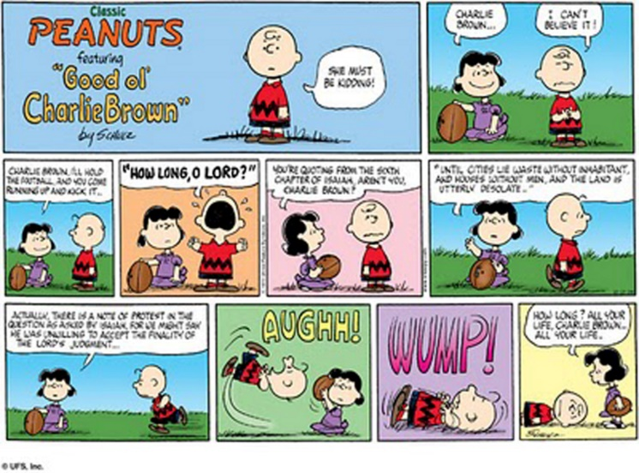
CS 118: Data Link Intro, Framing and Error Detection, Lecture 4
George Varghese
October 2024

Slide 2
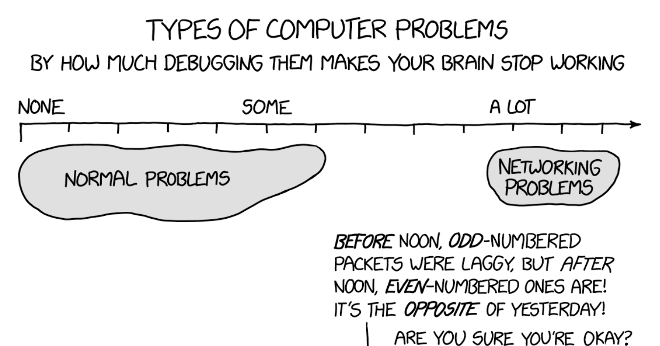

Slide 3

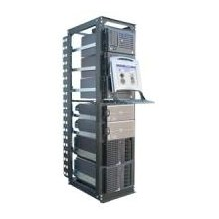
REVIEW: WHERE IS THE DATA LINK LAYER?
ROUGHLY, what happens when I click on a Web page from UCLA?
My computer
www.google.com
?
Internet

Slide 4

Web request (HTTP)
Turn click into HTTP request
GET http://www.google.com/ HTTP/1.1
Host: www.google.com
Connection:keep-alive
…

Slide 5

Name resolution (DNS)
Where is www.google.com?
My computer
(132.239.9.64)
Local DNS server
(132.239.51.18)
What’s the address for www.google.com
Oh, you can find it at 66.102.7.104

Slide 6
Data transport (TCP)
Break message into packets (TCP segments)
Should be delivered reliably & in-order
GET http://www.google.com HTTP/1.1
Host: www.google.com
Connection:keep-alive
…
3
google.c
2
p://www.
1
GET htt
“and let me know when they got there”

Slide 7
Network Layer: Global Network Addressing in IP
Address each packet so it can traverse network and arrive at host
My computer
(132.239.9.64)
www.google.com
(66.102.7.104)
Destination
Source
Data
66.102.7.104
132.239.9.64
1
GET htt

Slide 8
Network Routing in IP
Each router forwards packet towards destination
Sprint
UUNet
UCLA
www.google.com
(66.102.7.14)
Qwest
AT&T

Slide 9

Data Link scheduling (Ethernet)
Break message into frames (this lecture)
Check for errors (also this lecture)
Media Access Control (MAC)
Can I send now? Can I send now?
3 lectures from now
Send frame
Receiver

Slide 10
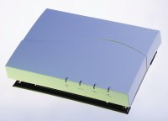
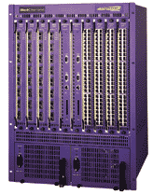
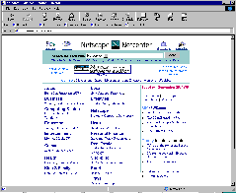
Physical layer (Lectures 2 - 3)
802.11b Wireless
Access Point
2.4Ghz Radio
DS/FH Radio
(1-11Mbps)
Cat5 Cable (4 wires)
100Base TX Ethernet
100Mbps
Ethernet switch/router
To campus
backbone
62.5/125um 850nm MMF
1000BaseSX Ethernet
1 Gbps

Slide 11
PHYSICAL LAYER: SUBLAYERS
Input Stream Output Stream 01010000 01010000
Coding Sublayer
Decoding Sublayer
Coded Stream
Coded Stream
Media Transmission
Media Reception
Sublayer
Sublayer
Input Signal
Output Signal
Signal Transmission Sublayer
(SHANNON AND NYQUIST LIMITS)
3
SEMI RELIABLE 1 HOP BIT PIPE

Slide 12
Copy File F at S
to File F at D
S
R1
R2
D
User Interface
Write (m) to connection queue
Read (m)
Transport (TCP)
Interface
^{F}6-8 | ^{F}2-5 | F₁
Send (segment) to D
Receive (segment)
Routing (IP) Interface
S
R1
R2
D
other paths?
Send (packet)
Receive (packet)
Data Link Interface
R1
R2
Send (bit)
Receive (bit)
Physical Layer Interface
Each layer provides a service to the layer above it

Slide 13
Data Link Sublayers
Point−to−point Links (2 nodes)
(e.g., HDLC, Frame Relay)
Broadcast Links (>= 2 nodes)
(e.g., Ethernet, Token Ring)
Frames
Frames
ERROR RECOVERY
(OPTIONAL)
MULTIPLEXING
MEDIA ACCESS
ERROR DETECTION
ERROR DETECTION
FRAMING
FRAMING
Bits
Bits
QUASI-RELIABLE 1 HOP FRAME PIPE

Slide 14
Data Link Sublayers
Point−to−point Links (2 nodes)
(e.g., HDLC, Frame Relay)
Broadcast Links (>= 2 nodes)
(e.g., Ethernet, Token Ring)
Frames
Frames
ERROR RECOVERY
(OPTIONAL)
MULTIPLEXING
MEDIA ACCESS
ERROR DETECTION
ERROR DETECTION
FRAMING
FRAMING
Bits
Bits
QUASI-RELIABLE 1 HOP FRAME PIPE

Slide 15
Five functions of Data Link
Five functions:
Framing: breaking up a stream of bits into units called frames so that we can extra information like destination addresses and checksums to frames. (Required.)
Error detection: using extra redundant bits called checksums to detect whether any bit in the frame was received incorrectly. (Required).
Media Access: multiple senders. Need traffic control to decide who sends next. (Required for broadcast links).
Multiplexing: Allowing multiple clients to use Data Link. Need some info in frame header to identify client. (Optional)
Error Recovery: Go beyond error detection and take recovery action by retransmitting when frames are lost or corrupted. (Optional)

Slide 16
Why not do error recovery at each hop?
End-to-end argument: Need end-to-end or transport error recovery anyway. Can’t trust a series of hop-by-hop schemes because:
Crashes and other losses at intermediate nodes.
Transport must work over both reliable and unreliable links.
Thus hop-by-hop only a performance optimization
Extra cost (ack messages, buffering) not worth it when error rate is low.
Worth it (quicker recovery, less wasted resources) when error rate is high and the latency of end-to-end recovery is unacceptable (within a compute cluster or storage area network).

Slide 17
End to end vs hop by hop example
Source
Dest
R1
R2
R3
R4
Case 1: suppose no bit errors and messages are 100 bytes and acks 50 bytes. 50% overhead for hop by hop. Hop-by-hop worthless!
Case 2: Suppose half the packets are being dropped on last hop between R3 and R4. Then without hop by hop we would retransmit on all hops using only end to end (6n versus 2n) where n is number of packets Hop by hop worthwhile!

Slide 18

How can we breakup a series of bits from the physical layer into a series of frames?
Part 1: Framing

Slide 19
Why Framing
Without framing, the bit stream is reserved for one sender and one client per sender. Need frames to add multiplexing information like destination addresses and destination client names.
Frames offer a small, manageable unit for error recovery and error detection. Add checksums to frames for error detection and sequence numbers etc. for error recovery.

Slide 20
How Framing
Flags and Bit Stuffing: Use special bit patterns or flags to delimit (i.e., mark boundaries) frames. Need bit stuffing to “encode” the user data not to contain the flags. (e.g., HDLC)
Start Flags and Character Count: Use flags to indicate the start of data and a bit count to indicate end of frame. Bit stuffing not needed but less robust. (e.g., DDCMP)
Flags supplied by Physical Layer: Use special physical layer symbols to delimit frames.

Slide 21
Fixed-Length Frames
Easy to manage for receiver
Well understood buffering requirements
Introduces inefficiencies for variable length payloads
May waste space (padding) for small payloads
Larger payloads need to be fragmented across many frames
Very common inside switches/routers

Slide 22
Length-Based Framing
Start
Length
Payload
To avoid overhead, we’d like variable length frames
Each frame declares how long it is
E.g. DECNet DDCMP
What’s the issue with explicit length field?
Must correctly read the length field (bad if corrupted)
Need to decode while receiving
Still need to identify the beginning…

Slide 23
Sentinel-based Framing
Allow for variable length frames
Idea: mark start/end of frame with special “marker”
Byte pattern, bit pattern, signal pattern
But… must make sure marker doesn’t appear in data
Two solutions
Special non-data physical-layer symbol
Code efficiency (can’t use symbol for data)?
Stuffing
Dynamically remove marker bit patterns from data stream
Receiver “unstuffs” data stream to reconstruct original data

Slide 24
Stuffing Design by Sublayering
Frame
01111110
Frame
Stuffer
Destuffer
No flags in frame
011111010
Add Flags01111110
Remove Flags
to Phy
from Phy
01111110 011111010 01111110
Sublayering is a good design technique within layers as well!
What happens if input data contains 0111110. If receiver gets 111110?

Slide 25
Bit-level Stuffing
Avoid sentinel bit pattern in payload data
Commonly, sentinel is bit pattern 01111110 (0x7E)
Invented for SDLC/HDLC, now standard pattern
Sender: any time five ones appear in outgoing data, insert a zero, resulting in 0111110
Receiver: any time five ones appear, removes next zero
If there is no zero, there will either be six ones (sentinel) or
It declares an error condition!
Note bit pattern that cannot appear is 01111111 (0x7F)
What’s the worst case for efficiency?
011111100001110111011111011111001
011111010000111011101111100111110001

Slide 26
Correct Bit Stuffing
S | S | S | S | FLAG
false flag ?
Case 1
false flag ?
Case 2
false flag ?
Case 3
Case 1: Easy, or we would have added a stuffed bit
Case 2: Stuff after 0 followed by 5 1’s does not work! Counterexample?
Case 3: Flag = 01010101 and stuff a 1 after 1 after 010101 does not work!
011111 1111110
011111 01111110
false flag ?
Case 2

Slide 27
Byte Stuffing
Same as bit stuffing, except at byte (character) level
Generally have two different flags, STX and ETX
Found in PPP still used in the wide area today
Need to stuff if either appears in the payload
Prefix with another special character, DLE (data-link escape)
New problem: what if DLE appears in payload?
Stuff DLE with DLE!
Could be as bad as 50% efficient to send all DLEs
STX
HEADER
Payload
ETX
0x48
ETX
0x69
0x48
DLE
ETX
0x69

Slide 28
The cheating solution
Ask the Physical Layer for more symbols that are never used in data.
Easily possible in 4-5 coding as we have 16 data symbols but 32 possible encoded values
Even after ruling out 00000 and 111111 we still have 14 unused symbols.
Change interface to allow sending one of 16 data symbols (0000 to 1111) and special symbols for start of frame (SOF) and End of Frame (EOF)
Data Link
Data Link
0000 to 1111
0000 to 1111
and SOF, EOF
Physical
Physical
OLD INTERFACE
NEW INTERFACE

Slide 29
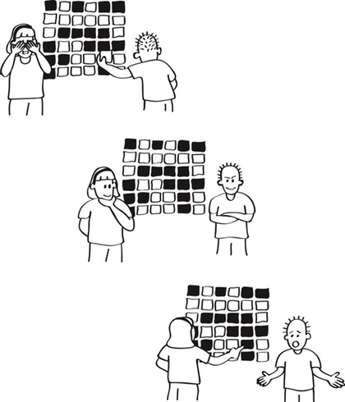
How can we add just 32 bits to a frame and detect almost any error with very high probability
Part 2: Error Detection

Slide 30
Goal: Quasi-reliability
The probability of a receiving Data Link passing up an incorrect frame to the client layer should be very, very small.
Undetected error say once in 20 years.
Needs to be so small because transport protocols do not insist on end-to-end checksums, a violation of end-to-end argument.
The probability of a receiving Data Link dropping frames sent by the sender should be small (once a day) to allow good performance.

Slide 31
Types of Errors
Random Errors. A noise spike or inter-symbol interference makes you think a 0 is a 1 or 1 to 0. Fiber: 1 in 10 ¹⁰
Burst errors: .A group of bits get corrupted because of synchronization or connector plugged in. Correlated!
Modeling Burst error: Burst error of length k → distance from first to last is k – 1. Intermediate may or may not be corrupted. Burst error of 5 starting at 50. Bits 50 and 54 are corrupted, bits 51-53 may or may not be corrupted
Goal for quasi-reliability: Like to add checksums to detect as large a burst (say 32) and as many random (at least 3)
Comparison: Imagine a frame of size 1000 and an error rate of 1 in 1000. If random, all frames corrupted on average. If we get a burst of 1000 every 1000 frames, only 1 is lost!

Slide 32
Error Detection using Parity
Parity: ExOR of bits. Can detect all odd bit errors in a frame. Can’t detect 2 bit errors. 1011 sent as 10111.
Would like to do better than parity using so-called checksums for detecting larger number of errors (happens often).

Slide 33
Detection versus Correction
Detection: code tells you some bit in frame has been corrupted, Response: drop frame and retransmit later
Correction: The code .tells you which bit is in error so you can correct it. Response: flip that bit
Prize Question: Computer disks corrupt bits but use error correction while networks use detection. Why?

Slide 34
Gentle Intro to Checksums
Telephone Exchange: Imagine you were sending you were reading a lot of numbers to a friend over a phone: e.g., 102, 205, 310. At the end you also send the sum (617)
Error Detection: If the sum your friend receives is not the sum of the numbers she received, there is an error
Undetected errors: An error that corrupts two numbers so the sum works out. 101, 205, 311, 616
CRCs: Instead of being based on addition they are based on division! Also they work Mod 2. Simplest to start with ordinary division and ignore Mod 2.

Slide 35
ORDINARY DIVISION CHECKSUM
Consider message M and generator G to be binary integers.
Let r be number of bits in G. We find the remainder t of 2^{r}M when divided by G. Why not just M ? So that we can separate checksum from message at receiver by looking at last r bits.
Thus 2^{r}M = k.G + t. Thus:
2^{r}M + G − t = (k + 1)G. So we add a checksum
c = G − t to the shifted message and the result should divide G.
Example: M = 110010 (50), r = 3, G = 7. After shifting 3 bits, we get 400. Remainder t = 1, checksum = 6. So we send 110010 110 which is divisible by 7 (406)
Has reasonable properties. However integer division hard to implement. Prefer to do without carries.

Slide 36
The Big Idea
In ordinary division checksums we transmitted a message plus checksum that was divisible by the generator G. Thus any errors that cause the resulting number to be not divisible by G (invalid codewords) will be detected.
In CRCs, we do the same thing except that we use Mod 2 arithmetic instead of ordinary arithmetic
Mod 2 arithmetic: addition and subtraction are XORs so there is no carry. Can implement at high speeds which we need in networks (Terabits)

Slide 37
MODULO 2 ARITHMETIC
No carries. Repeated addition does not result in multiplication. e.g. 1100 + 1100 = 0000;
1100 + 1100 + 1100 = 1100
Multiplication is normal except for no carries: e.g. 1001 ∗ 11 = 10010 + 1001 = 11011. Shift and Ex-or instead of Shift and Add as in normal arithemtic.
Similar algorithm to ordinary division. Again let r be number of bits in G. We find the remainder c of 2^{r−1}M when divided by G. Why only shift r − 1 bits this time?
Thus 2^{r−1}M = k.G + c. Thus 2^{r−1}M − c = k.G. Thus 2^{r−1}M + c = k.G (addition same as subtraction). Send c as checksum

Slide 38
Recall how ordinary division works
118
------------- 7344
62
---- 114
62
---
524
496
----
28
62
Can be viewed as repeated subtractions of multiples of 62 (i.e., 6200, 620, 496) until we get a number less than 62, which is the remainder.

Slide 39
How Mod 2 Division Works
Generator Shifted Message
1 | 1 | 1 | 1 1 | 0 | 0 | 0
 |  |  | 1 1 | 1
0 | 1 | 0
0 | 0 | 0
 | 1 | 0 | 0
 | 1 | 1 | 1
 | 0 | 1 | 1
For CRC, we need to repeatedly add (mod 2) multiples of the generator until we get a number that is r − 1 bits long that is the remainder.
The only way to reduce number of bits in Mod 2 arithmetic is to remove MSB by adding (mod 2) a number with a 1 in the same position.
While no more bits
If MSB = 1, XOR with generator (RED)
Shift out MSB and Shift in next bit (BLUE)

Slide 40
Implementing CRCs
Current Remainder
Message bits shifted in
Divisor
The current remainder is held in a register initialized with first r bits of the message.
If MSB of current remainder is 1, then EXOR current remainder with divisor; if the MSB is 0, do nothing.
Shift the current remainder 1 bit to the left and shift in next message bit.

Slide 41
CRC in Hardware: LFSR
R4
+
R3 R2
⁺ R1 R0 ⁺
Message Bits
Generator String = 1 1 0 1 0 1
Registers R0 through R4 are several single bit registers corresponding to the single multibit register in previous slide.
Ex-OR placed to right of register i if bit i set in generator.
When a message bit shifts in, all registers send (in parallel) their bit values to left, some through Ex-OR gates. Combines left shift of an iteration with MSB check and Ex-OR of next iteration. Ex-OR during left shift.
Avoids check for MSB: output of R4 as input to all Ex-ORs.
In practice to implement at Terabits we need to shift multiple bits (say 8) per clock cycle.
So CRCs can be implanted at high speeds. But what errors do they catch? Need a new viewpoint

Slide 42
CRC PROPERTIES
CRC-16: X¹⁶ + X¹⁵ + X² + 1 = 11000000000000101
We skip proofs of these properties this quarter but they are in your notes, Not required for HWs and tests.
Odd bit errors: can handle but not a big deal as parity can handle with using just 1 bit. 1
Two bit errors specially designed CRCs can do this. Beats parity!
Burst errors: CRC-32 can catch any 32 bit burst error for sure. Further it can catch larger burst errors with very high probability: (1 - 1/ 2³² )
Summary: So the big deal is that it can for sure catch up to 3 bit errors, and can detect any error with very high probability. Like a hash function with with some deterministic guarantees

Slide 43
Lessons from Framing and CRCs
End-to-end argument.
Sublayering is a powerful tool: bit stuffing implementation, error recovery on top of framing. Sublayers extract their penalty
Common problems at layers and exploiting solutions at other layers: coding, bit and frame synchronization, getting extra symbols from physical layer.
Arguing by Analogy: ordinary division and CRC. Helps when trying to do CRC multiple bits at a time.

Slide 44
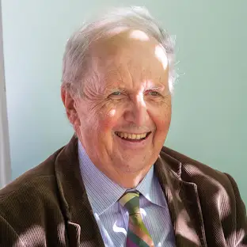
EPILILOG: SMITH ON GENEROSITY TO A SPITEFUL LETTER WRITER
“I believe you wrote me some letters. I know you claim you did not do this but I have enough evidence to satisfy me at least, it was you.
I am writing to say sorry to you. The only reason to write these letters was that I must have done something in the past to make you angry. You should not have written the way you did, but I am still saying sorry for anything we have done
.“
~ Smith, In the Miracle at Speedy Motors

